Slide 1
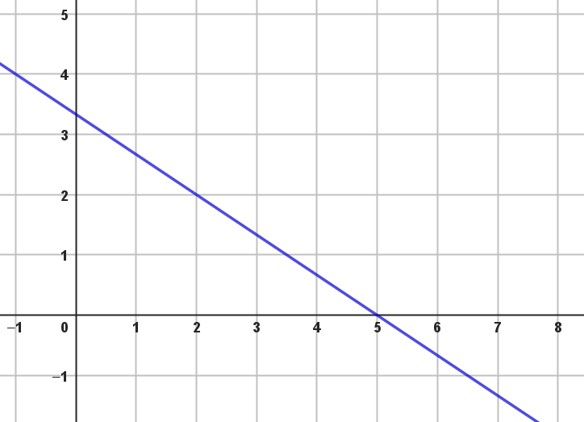
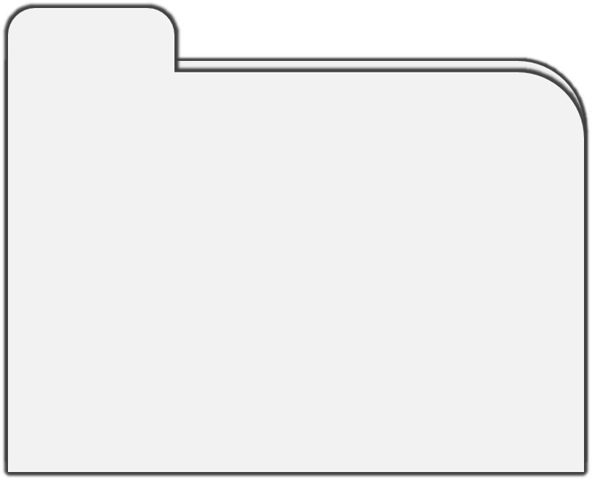
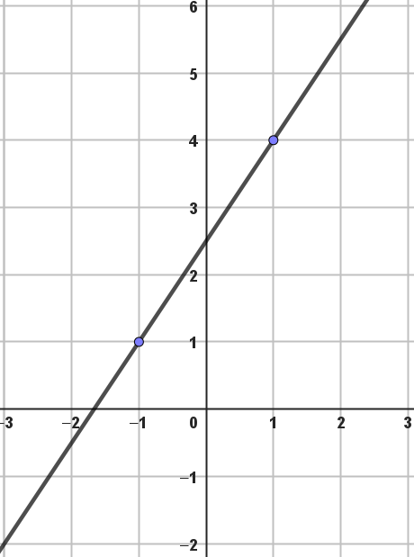
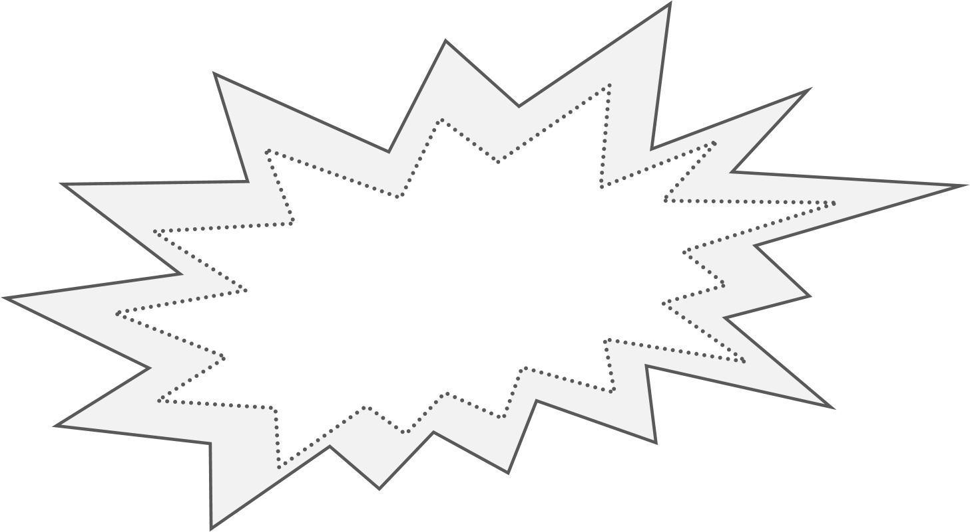
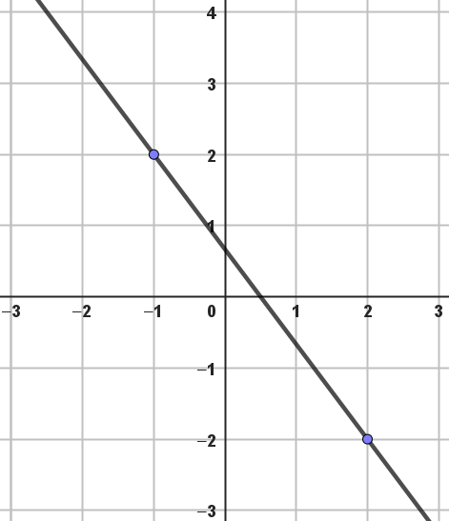







1.2B Writing the formula of a Line
Write the formule for line $n$ in the figure.
How to do and notate this:
Let
Through (-1,4) and (2,2), so $a=\frac{−2}{3}$
$$\left.\begin{matrix}n:y=−\frac{2}{3}x+b \\ through (2,2)\end{matrix}\right\} −\frac{2}{3}∙2+b=2 \\ −1\frac{1}{3}+b=2 \\ b=2+1\frac{1}{3}=3\frac{1}{3} \\ so n:y=−\frac{2}{3x}+3\frac{1}{3}$$
y
n
EXAMPLE
x
Write the formula for line k in the figure, mimic the example!
y
Let k: y=ax+b,
Through (___,___) and (___,___), so $a=\frac{3}{2}=1\frac{1}{2}$
So, k: $y=1\frac{1}{2}x+b$
through (___,___)
So k: $y=1\frac{1}{2}x+______$
$$k$$
Use fractions here!
$1\frac{1}{2}⋅____+b$ =_____
x
YOUR TURN
Choose two gridpoints
y
Write the formula for line l in the figure, mimic the example!
$$l$$
Let _______________
Through (___,___) and (___,___), so $a=\frac{}{}=$
So, l: $y=____x+b$
through (___,___)
So ______________________________
Use fractions here!
x
$____⋅____+b$ =_____
YOUR TURN
Your line heads down, what does this mean for the gradient?
CH1 DoodleNote Writing the formula of a line © 2023 by Annemieke Mens is licensed under CC BY-SA 4.0.
3
ath by rs. ens
3
3
3
3

