Slide 1
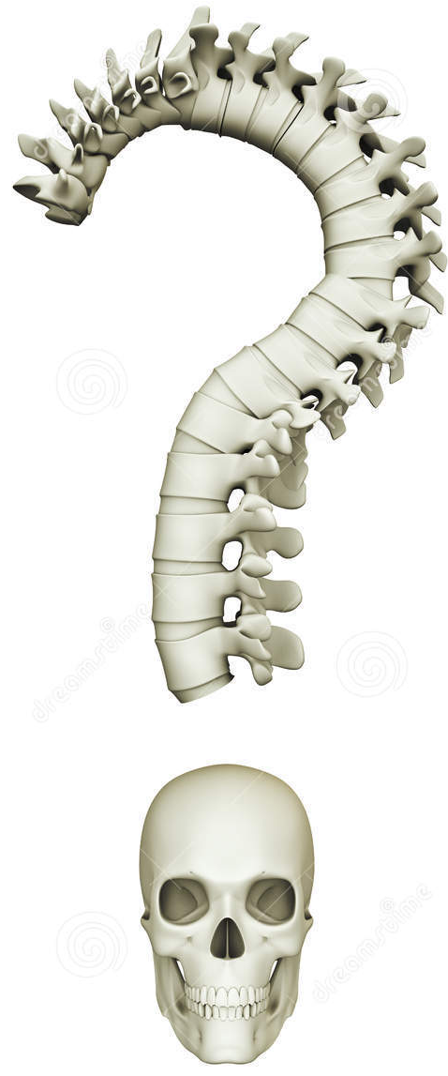
Special adaptations
Some animals have adaptations to their endoskeleton to be able to survive better.
Come up with three different animals with different endoskeletons.
Describe what kind of endoskeleton it is and how it helps the animal survive better.

Slide 2
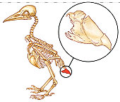
Special adaptations
Birds have very light endoskeletons to make flying possible.
The skeleton also must be strong, to handle take-off and landing.
To increase strength, some bones
are fused, the pygostyle for example.

Slide 3
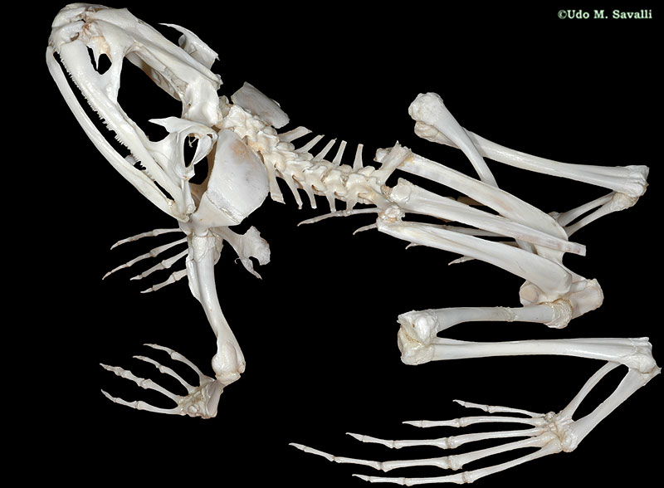
Special adaptations
Amphibians, like frogs and newts, live both on land and in the water.
Their skeletons are adapted so they have advantages in both habitats.
What kind of adaptations
do they have?

Slide 4
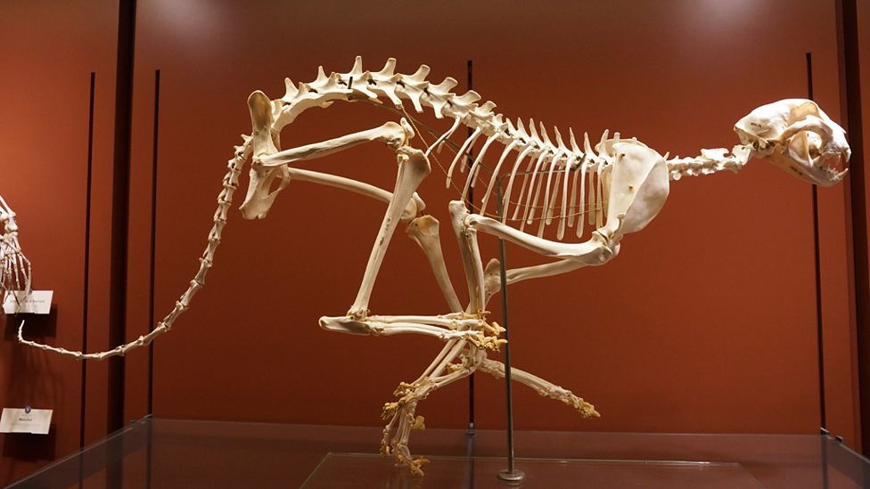
Special adaptations
Predators such as the cheetah also have adapted endoskeletons.
A cheetah has a stride of 8 metres and a top speed of 110-120 km/h.
What adaptations does a cheetah have to make him a fast predator?

Slide 5
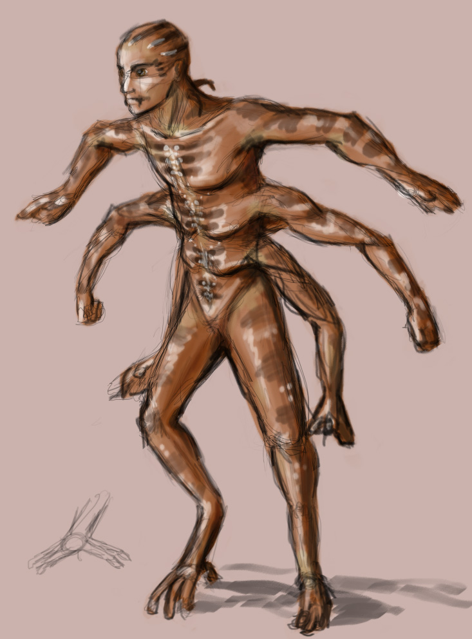
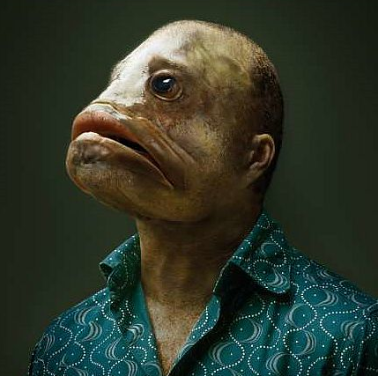
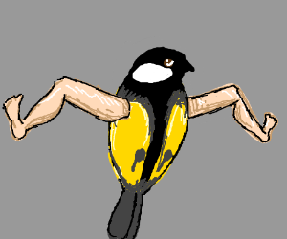
Your adaptations!
Think of three adaptations you would do to your own skeleton! Make a drawing of this.
Explain how these adaptations will help you (survive).

Slide 6

Question/Discussion
Make a drawing
Add a text explaining your drawing
Upload it to your portfolio

